Slide 1

Correlation between Malaga and Toronto Neighborhoods
IBM Data Science Capstone Project (Coursera)

Slide 2
INTRODUCTION
Developing a Machine Learning solution to identify the best possible neighborhood to move in to
PROBLEM DESCRIPTION
Given a neighborhood X in the city of Toronto, which neighborhoods in Malaga have the same kind of venues?
TARGET AUDIENCE
Real estate agencies in Málaga and Toronto
International companies hiring people from another country
Families moving in abroad
SUCCESS CRITERIA
A good recommendation of similar neighborhoods, i.e., same kind of venues, leisure opportunities, green areas and so on, to people moving from Malaga to Canada

Slide 3




Project analysis slide 2
DATA DESCRIPTION
WIKIPEDIA (Toronto Neighborhoods)
OPENSTREETMAP (Malaga Neighborhoods)
DATA SOURCES
NOMINATIM API (Addresses → Coordinates)
FOURSQUARE API (Nearby Venues)
FOLIUM (Maps Creation)
ARCGIS API (Obtain Coordinates)

Slide 4


Project analysis slide 3
Methodology
DATA COLLECTION
DATA WRANGLING
DATA EXPLORING
MACHINE LEARNING
RESULTS DISCUSSION
Scraping webpages to obtain Málaga and Toronto neighborhood data and using ArcGIS API to get its corresponding coordinates.
Preparing and cleaning data content and format through basic processing, such as dropping columns or merging dataframes.
Using Foursquare API to get the top 100 venues per neighborhood within a radius of X meters. Calculating frequency of occurrences of each venue category.
Running a Clustering Algorithm, K-Means, to find potential relations and similarities between the neighborhoods of both cities under study.
Analyzing all clusters outputted by K-Means to understand which are the common aspects between the neighborhoods belonging to the same cluster.

Slide 5
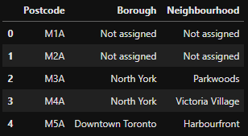
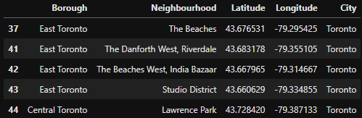
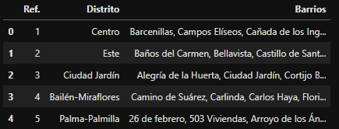
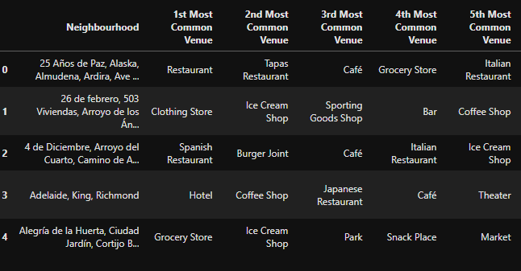
Project analysis slide 3
Methodology
DATA COLLECTION
DATA WRANGLING
Toronto data
DATA EXPLORING
Málaga data

Slide 6
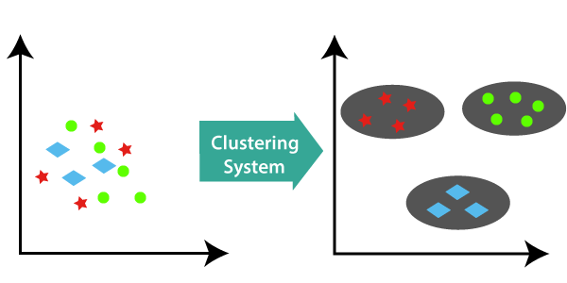
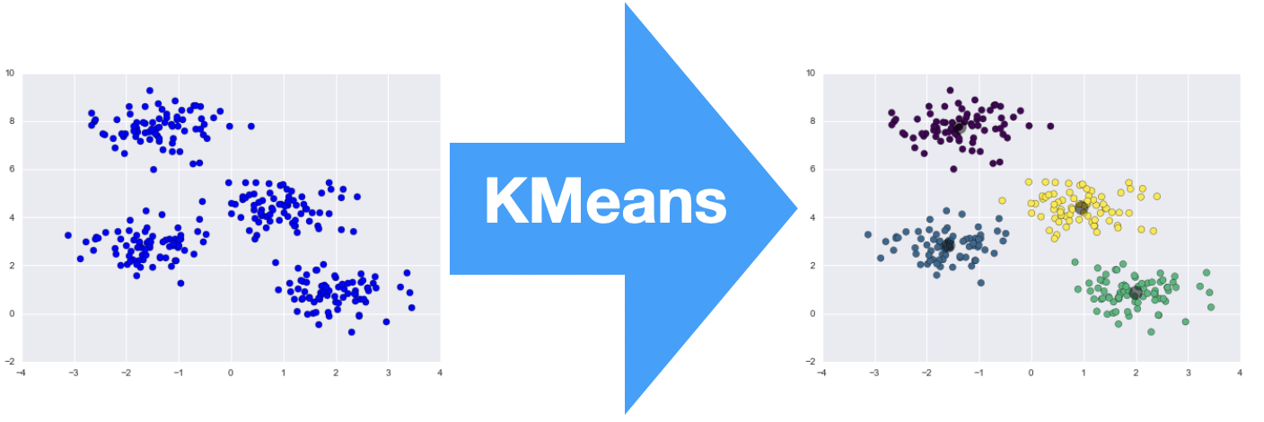
Project analysis slide 3
Methodology
MACHINE LEARNING
sklearn.cluster.KMeans(n_clusters=k, n_init=50, random_state=5)
n_clusters
Maximize the number of clusters where there is at least one Malaga neighborhood and one Toronto neighborhood. In this way, we will be able to establish relations between both cities. Therefore, the first step is to search for the optimal “k” value from the “Malaga and Toronto sharing clusters” point of view.
n_init
Number of time the k-means algorithm will be run with different centroid seeds. The result will be the best output of n_init consecutive runs in terms of inertia. Using a higher number (50) than the default one (10) to ensure a better centroid seed.
random_state
Using an integer, 5 in this case, to make the randomness deterministic.

Slide 7
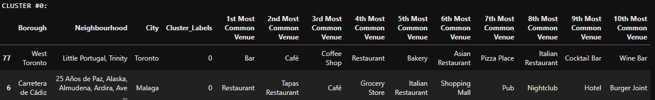
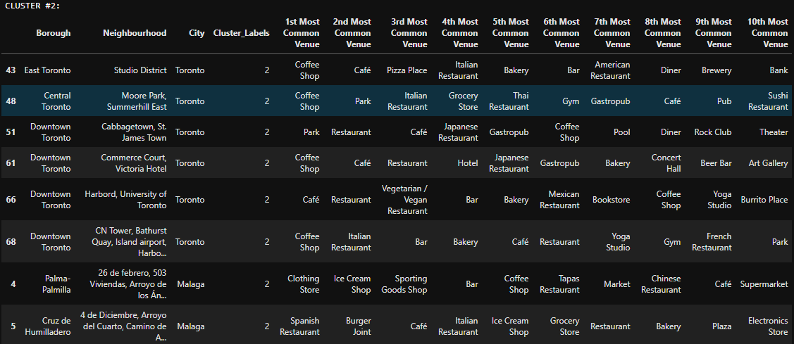
Project analysis slide 3
CLUSTERING RESULTS
5 out of 20 Clusters contain Malaga and Toronto neighborhoods together

Slide 8
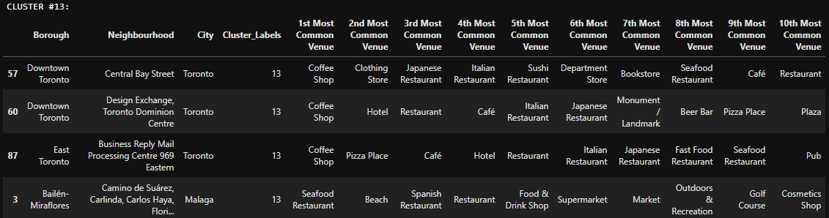
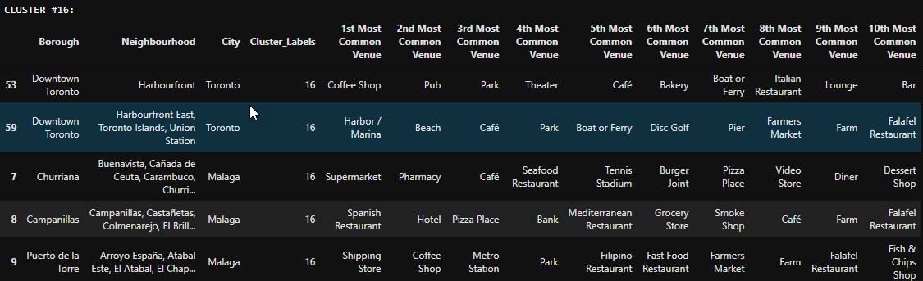
Project analysis slide 3
CLUSTERING RESULTS
5 out of 20 Clusters contain Malaga and Toronto neighborhoods together

Slide 9
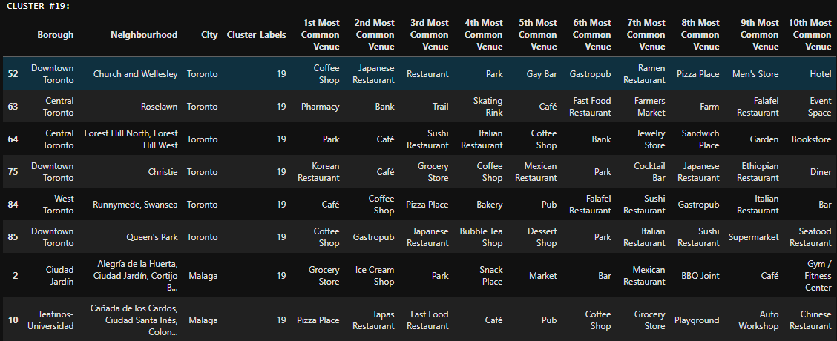
Project analysis slide 3
CLUSTERING RESULTS
5 out of 20 Clusters contain Malaga and Toronto neighborhoods together

Slide 10
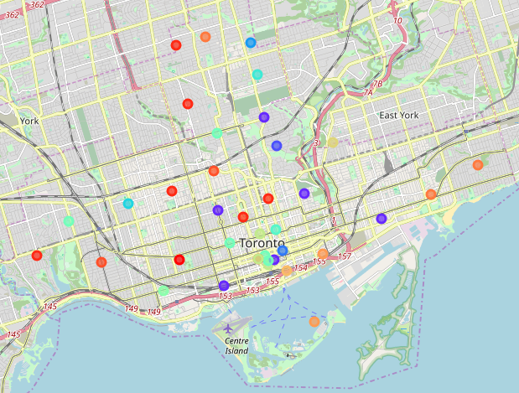
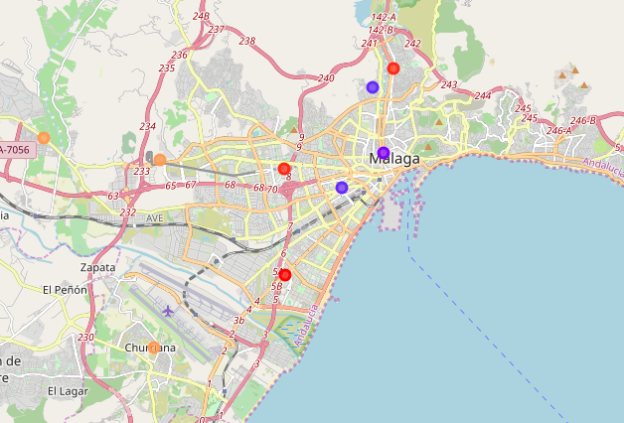
Project analysis slide 3
CLUSTERING RESULTS
Toronto
MALAGA

Slide 11
Project analysis slide 3
DISCUSSION
Cluster 0: There is 1 Toronto Neighborhood and 1 Malaga Neighborhood where the main spots are cheap Restaurants and Pubs. Due to this, we can name this cluster as Teenagers and Nightlife
Cluster 2: There are 6 Toronto Neighborhoods and 2 Malaga Neighborhoods where the main spots are Restaurants (Italian, Fast Food, Japanese ...) and Cafés. Due to this, we can name this cluster as Restaurants and Cafés
Cluster 13: There are 3 Toronto Neighborhoods and 1 Malaga Neighborhood where there a huge mix of everything (shops, cafés, department stores, hotels, pubs ...). Due to this, we can name this cluster as Regular
Cluster 16: There are 2 Toronto Neighborhoods and 3 Malaga Neighborhoods where the main spots are places close or related to the sea (Harbors, Ferries, Seafood Restaurants .... ) and Farmer Markets. Due to this, we can name this cluster as Sea and Farms
Cluster 19: There are 6 Toronto Neighborhoods and 2 Malaga Neighborhoods where the main spots are Asian restaurants (sushi, Japanese, Korean ...), Cafés (or Coffee Shops) and Parks. Due to this, we can name this cluster as Asian Restaurants, Cafés and Parks

